Slide 1
Stakeholder or Institutional Information
and
Operations Research Modeling

Slide 2
Regulatory Environment
Supply chain echelons
SF rates + fragmentation
Consumption rates
Sampling budget
Recall action timeliness
Strategic Decisions
Medicine classes
Pharmacy subset
Diagnostic Tool
Sensitivity/Specificity
Deployment capacity
Operational Decisions
Threshold for recall initiation
When + where to sample
Operations Research Framework
Drug selection
Qualitative Feedback
p threshold
Data Collection + Analysis
Sampling plan
Tool modifications
Notes:
Strategic Decisions
Drug types to test
Subset of pharmacies to study
Diagnostic Tool
Sensitivity + Specificity
Ability to detect API content + fillers
Influence of different levels of training
Effect or tradeoffs of tool modifications
DRA Environment
Drug supply-chain echelons
Rates of falsification / sub-standardization
Costs of falsification to illicit actors
Drug consumption rates
Levels of fragmentation of SSFFCs
Market distribution across fragments
Recall action timelines and limits
Lab/HPLC capacity
Drug market stakeholders
Operational Decisions
Financial + diagnostic sampling budget
Threshold for issuing recall action
Where + when + how much to sample

Slide 3

Mixed-Methods Framework
Qualitative feedback feeds hypothesis formation regarding fragmentation
Strategic Decisions
Pharmaceutical classes to test
Pharmacy subset to monitor
Tactical & Operational Decisions
When + where to sample
Order of sampling
Sampling is conducted and data analyzed
Budgetary Base Model
$\hat{p}$ thresholds established
External Environment
Supply chain structure
SF rates + fragmentation
Consumption rates
Sampling budget
Recall action timeliness
Diagnostic Tool
Sensitivity/Specificity
Deployment capacity
Notes:
Strategic Decisions
Drug types to test
Subset of pharmacies to study
Diagnostic Tool
Sensitivity + Specificity
Ability to detect API content + fillers
Influence of different levels of training
Effect or tradeoffs of tool modifications
DRA Environment
Drug supply-chain echelons
Rates of falsification / sub-standardization
Costs of falsification to illicit actors
Drug consumption rates
Levels of fragmentation of SSFFCs
Market distribution across fragments
Recall action timelines and limits
Lab/HPLC capacity
Drug market stakeholders
Operational Decisions
Financial + diagnostic sampling budget
Threshold for issuing recall action
Where + when + how much to sample

Slide 4
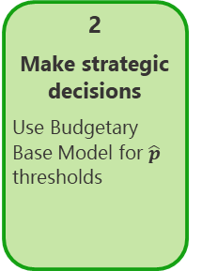

Mixed-Methods Framework
1
Establish fragmentation hypotheses
2
Make strategic decisions
Use Budgetary Base Model for $\hat{p}$ thresholds
3
Complete tactical & operational decisions
When + where to sample
Order of sampling
4
Conduct sampling
5
Analyze data
Is detection feasible under current $\hat{p}$ assumptions?
6
Gather feedback
How to adjust future sampling?
External Environment
Supply chain structure
SF rates + fragmentation
Consumption rates
Sampling budget
Recall action timeliness
Diagnostic Tool
Sensitivity/Specificity
Deployment capacity
Notes:
Strategic Decisions
Drug types to test
Subset of pharmacies to study
Diagnostic Tool
Sensitivity + Specificity
Ability to detect API content + fillers
Influence of different levels of training
Effect or tradeoffs of tool modifications
DRA Environment
Drug supply-chain echelons
Rates of falsification / sub-standardization
Costs of falsification to illicit actors
Drug consumption rates
Levels of fragmentation of SSFFCs
Market distribution across fragments
Recall action timelines and limits
Lab/HPLC capacity
Drug market stakeholders
Operational Decisions
Financial + diagnostic sampling budget
Threshold for issuing recall action
Where + when + how much to sample

Slide 5
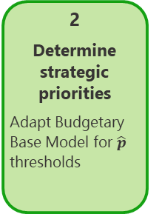
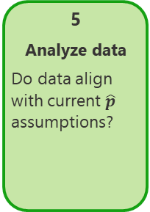
Mixed-Methods Framework
1
Establish fragmentation hypotheses
2
Determine strategic priorities
Adapt Budgetary Base Model for $\hat{p}$ thresholds
3
Complete tactical & operational decisions
When + where to sample
Order of sampling
4
Conduct sampling
5
Analyze data
Do data align with current $\hat{p}$ assumptions?
6
Gather feedback
How to adjust future sampling?
External Environment
Supply chain structure
SF rates + fragmentation
Consumption rates
Sampling budget
Recall action timeliness
Diagnostic Tool
Sensitivity/Specificity
Deployment capacity
Notes:
Strategic Decisions
Drug types to test
Subset of pharmacies to study
Diagnostic Tool
Sensitivity + Specificity
Ability to detect API content + fillers
Influence of different levels of training
Effect or tradeoffs of tool modifications
DRA Environment
Drug supply-chain echelons
Rates of falsification / sub-standardization
Costs of falsification to illicit actors
Drug consumption rates
Levels of fragmentation of SSFFCs
Market distribution across fragments
Recall action timelines and limits
Lab/HPLC capacity
Drug market stakeholders
Operational Decisions
Financial + diagnostic sampling budget
Threshold for issuing recall action
Where + when + how much to sample

Slide 6
Mixed-Methods Framework
1
Establish fragmentation hypotheses
2
Determine strategic priorities
Adapt Budgetary Base Model for $\hat{p}$ thresholds
3
Complete tactical & operational decisions
When + where to sample
Order of sampling
4
Conduct sampling
5
Analyze data
Do data align with current assumptions?
6
Gather feedback
Adjust future sampling
External Environment
Supply chain structure
SFP rates + fragmentation
Consumption rates
Sampling budget
Recall action timeliness
Screening Tool
Sensitivity/Specificity
Deployment capacity
Notes:
Strategic Decisions
Drug types to test
Subset of pharmacies to study
Diagnostic Tool
Sensitivity + Specificity
Ability to detect API content + fillers
Influence of different levels of training
Effect or tradeoffs of tool modifications
DRA Environment
Drug supply-chain echelons
Rates of falsification / sub-standardization
Costs of falsification to illicit actors
Drug consumption rates
Levels of fragmentation of SSFFCs
Market distribution across fragments
Recall action timelines and limits
Lab/HPLC capacity
Drug market stakeholders
Operational Decisions
Financial + diagnostic sampling budget
Threshold for issuing recall action
Where + when + how much to sample

Slide 7
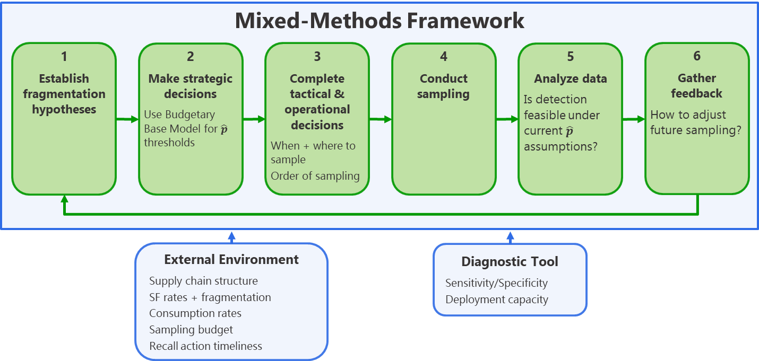
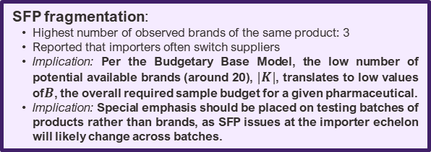
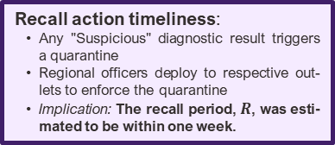
Hypotheses regarding fragmentation:
Overall prevalence of SFPs mostly unknown
Acknowledged by all stakeholders that substandard manufacture and storage were issues of concern throughout the entire supply chain
Guinea cited as the primary source of falsified pharmaceuticals, with Guinea-bordering regions at the highest risk
Rainy-season road conditions great-ly inhibit the ability to reach south-eastern regions from Monrovia
Implication: Comprehensive sam-pling plans should account for the possibility of significant regional differences in terms of falsifi-cation prevalence, but maintain expectations of substandardiza-tion problems throughout the en-tire country.
Pharmaceutical classes to test:
Common stockouts: Amoxicillin, paracetamol, and anti-malarials
Products cited as most valuable: Amoxicillin, paracetamol, anti-malarials, ampiclox, amp-icillin, and doxycycline
Implication: The consistency of these reports across outlets indicates that SFP tendencies might be most likely with respect to these products.
Diagnostic tools and deployment capacity:
Reagent availability is far more constraining than laboratory testing time or technician ca-pacity
A significant laboratory burned down in 2017 (FrontPage Af-rica, 2019) and funding for a replacement is still a work-in-process
Implication: Inexpensive and deployable diagnostics such as the PAD can occupy an important role in the overall surveillance paradigm.
Recall action timeliness:
Any "Suspicious" diagnostic result triggers a quarantine
Regional officers deploy to respective out-lets to enforce the quarantine
Implication: The recall period, $R$, was esti-mated to be within one week.
SFP fragmentation:
Highest number of observed brands of the same product: 3
Reported that importers often switch suppliers
Implication: Per the Budgetary Base Model, the low number of potential available brands (around 20), $|K|$, translates to low values of$B$, the overall required sample budget for a given pharmaceutical.
Implication: Special emphasis should be placed on testing batches of products rather than brands, as SFP issues at the importer echelon will likely change across batches.
Supply chain structure:
Low complexity
No domestic pharmaceutical production
Limited scale (~20 private importers)
Implication: An overall constrained num-ber of SFP sources suggests strong prospects for feasible sampling plans.
Notes:
Strategic Decisions
Drug types to test
Subset of pharmacies to study
Diagnostic Tool
Sensitivity + Specificity
Ability to detect API content + fillers
Influence of different levels of training
Effect or tradeoffs of tool modifications
DRA Environment
Drug supply-chain echelons
Rates of falsification / sub-standardization
Costs of falsification to illicit actors
Drug consumption rates
Levels of fragmentation of SSFFCs
Market distribution across fragments
Recall action timelines and limits
Lab/HPLC capacity
Drug market stakeholders
Operational Decisions
Financial + diagnostic sampling budget
Threshold for issuing recall action
Where + when + how much to sample

Slide 8


Initial Batch Size
Drug Amount
Captured Product Amount
Diagnosis
Time
$$L$$
$$R$$
8

Slide 9

$$\hat{p}$$
9

Slide 10
10

Slide 11
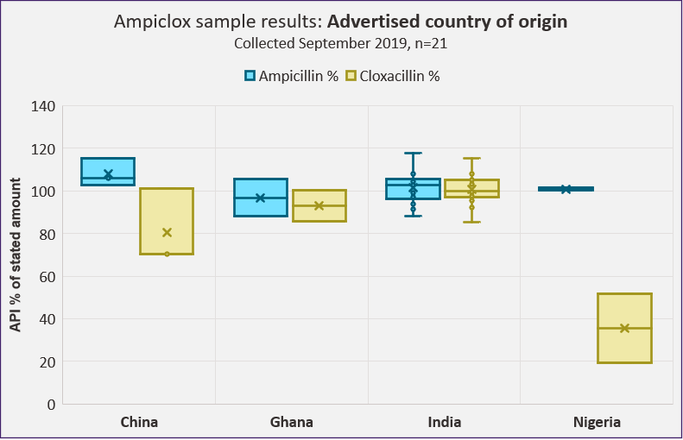
11

Slide 12
12

Slide 13
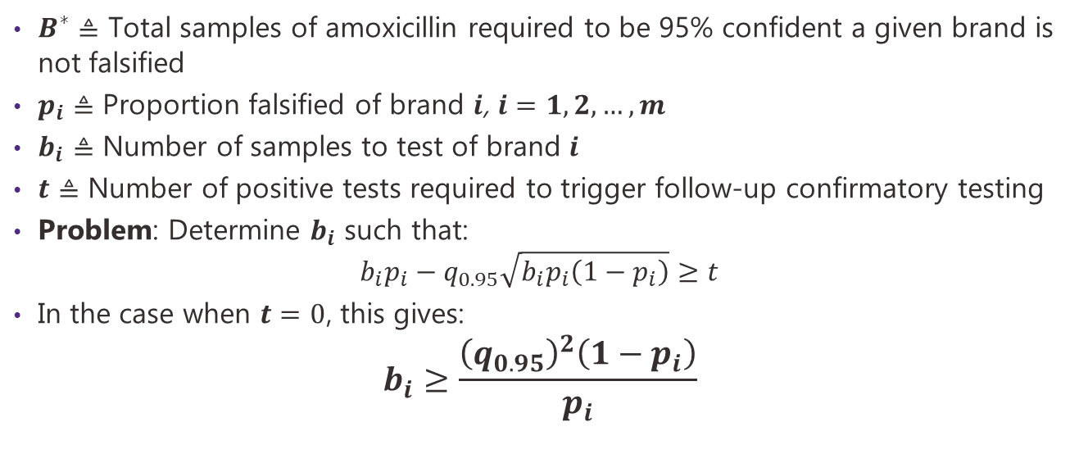
Do we have enough samples for detection?
$B^{∗}≜$ Total samples of amoxicillin required to be 95% confident a given brand is not falsified
$p_{i}$ $≜$ Proportion falsified of brand $i$, $i=1,2,…,m$
$b_{i}$ $≜$ Number of samples to test of brand $i$
$t$ $≜$ Number of positive tests required to trigger follow-up confirmatory testing
Problem: Determine $b_{i}$ such that:
$$b_{i}p_{i}−q_{0.95}\sqrt{b_{i}p_{i}\left(1−p_{i}\right)}≥t$$
In the case when $t=0$, this gives:
$$b_{i}≥\frac{{\left(q_{0.95}\right)}^{2}\left(1−p_{i}\right)}{p_{i}}$$
Related to Lot-Quality Assurance Sampling
13

Slide 14
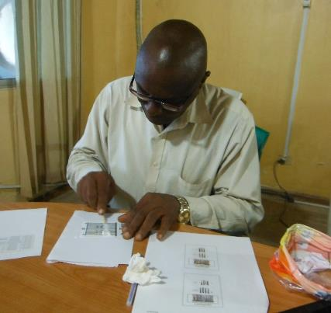
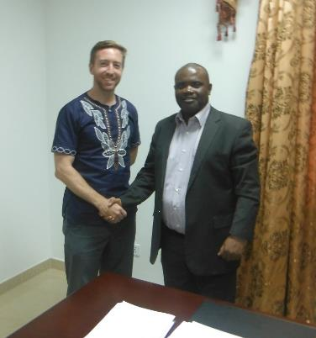
Case study in Liberia
3-week trip in September to assess data and establish relationships with the Liberian Medicines and Health Products Regulatory Authority (LMHRA)
Wide array of constraints
Lab funding
Staffing levels
Budget for post-market sample procurement
Potential for success
Accessible data
Manageable supply chains
High buy-in to OR approach
14

Slide 15
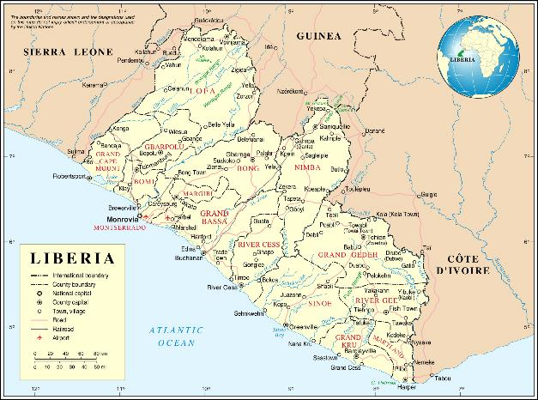
Public sector
Private sector
Black market
15

Slide 16

Public sector
Private sector
Black market
16

Slide 17
Takeaways
Success is possible in certain contexts
Reinvent the wheel
Collaboration is key
17

Slide 18
Thank you!
18

Slide 19
Batch arrivals from manufacturer or intermediary
Drug Packet
Batch ID
Size
Node History
Other details
Time unit: Days
Number of drug types: 1
End Node
LT from intermediate nodes
Reorder point/amount
Intermediate node preferences
Vector of current inventories from each intermediate node
Vector of incoming inventories of each brand
Demand schedule
Demand results (satisfied/stockout)
Intermediate Node
LT from root nodes
Probability of procuring from each root node
Reorder point/amount
Vector of current inventories of each brand
Orders placed
Order received
19
Notes:
Strategic Decisions
Drug types to test
Subset of pharmacies to study
Diagnostic Tool
Sensitivity + Specificity
Ability to detect API content + fillers
Influence of different levels of training
Effect or tradeoffs of tool modifications
DRA Environment
Drug supply-chain echelons
Rates of falsification / sub-standardization
Costs of falsification to illicit actors
Drug consumption rates
Levels of fragmentation of SSFFCs
Market distribution across fragments
Recall action timelines and limits
Lab/HPLC capacity
Drug market stakeholders
Operational Decisions
Financial + diagnostic sampling budget
Threshold for issuing recall action
Where + when + how much to sample

Slide 20
Overall Simulation Timeline
Process incoming IMPORTER orders
Process incoming RX orders
Observe RX demand
Beginning of time unit
Update remaining lead time
Update remaining lead time
Update consumption records
Place RX orders if r reached
Place IMPORTER orders if r reached
End of time unit
20
Notes:
Strategic Decisions
Drug types to test
Subset of pharmacies to study
Diagnostic Tool
Sensitivity + Specificity
Ability to detect API content + fillers
Influence of different levels of training
Effect or tradeoffs of tool modifications
DRA Environment
Drug supply-chain echelons
Rates of falsification / sub-standardization
Costs of falsification to illicit actors
Drug consumption rates
Levels of fragmentation of SSFFCs
Market distribution across fragments
Recall action timelines and limits
Lab/HPLC capacity
Drug market stakeholders
Operational Decisions
Financial + diagnostic sampling budget
Threshold for issuing recall action
Where + when + how much to sample

Slide 21
Simulation Schematic
Falsification_Sim_Classes.py
Object definitions
Fundamental SC logic: demand, orders, etc.
Structural Inputs (CSV files)
Node List
Essential descriptive data
Arc Lists
Node rankings
IMP-dependent LTs + reorder amounts (optional)
Parameter Inputs
Number of days
Number of replications
Size of sampling budget
Designation of testing policy
Diagnostic capacity
Estimation inputs
Falsification_Sim_Modules.py
Functions that streamline various simulation processes
I/O processing
Schedule generation
NUTS sampling
Falsification_Simulator.py
Primary simulation engine
Falsification_Simulator_TestPolicies.py
Static and dynamic test schedule generators
Printed Outputs
Tables
Figures
Output Dictionaries (Python files)
Contain all relevant post-simulation processing data and statistics
Falsification_Sim_EstimationMethods.py
Tools for estimating SF prevalence from end node testing data
Analysis
Notes:
Strategic Decisions
Drug types to test
Subset of pharmacies to study
Diagnostic Tool
Sensitivity + Specificity
Ability to detect API content + fillers
Influence of different levels of training
Effect or tradeoffs of tool modifications
DRA Environment
Drug supply-chain echelons
Rates of falsification / sub-standardization
Costs of falsification to illicit actors
Drug consumption rates
Levels of fragmentation of SSFFCs
Market distribution across fragments
Recall action timelines and limits
Lab/HPLC capacity
Drug market stakeholders
Operational Decisions
Financial + diagnostic sampling budget
Threshold for issuing recall action
Where + when + how much to sample

Slide 22
Timeline at pharmacy
Orders arrive
Demand observed
Orders placed
Beginning of time unit
End of time unit
Any stockouts are recorded
Randomly iterate through pharmacies, processing demand by preference
22
Notes:
Strategic Decisions
Drug types to test
Subset of pharmacies to study
Diagnostic Tool
Sensitivity + Specificity
Ability to detect API content + fillers
Influence of different levels of training
Effect or tradeoffs of tool modifications
DRA Environment
Drug supply-chain echelons
Rates of falsification / sub-standardization
Costs of falsification to illicit actors
Drug consumption rates
Levels of fragmentation of SSFFCs
Market distribution across fragments
Recall action timelines and limits
Lab/HPLC capacity
Drug market stakeholders
Operational Decisions
Financial + diagnostic sampling budget
Threshold for issuing recall action
Where + when + how much to sample

Slide 23
Public supply chain
Central Medicine Store
(Receives inventory as pushed by donors)
(Allocates inventory proportionally to HF demand)
County Depot
(Operates only as a potential falsification or substandard opportunity)
Health Facilities
Facility ID
Regional ID
Vector of current inventories of each brand
Demand schedule
Stockouts of tracer drugs (?)
23
Notes:
Strategic Decisions
Drug types to test
Subset of pharmacies to study
Diagnostic Tool
Sensitivity + Specificity
Ability to detect API content + fillers
Influence of different levels of training
Effect or tradeoffs of tool modifications
DRA Environment
Drug supply-chain echelons
Rates of falsification / sub-standardization
Costs of falsification to illicit actors
Drug consumption rates
Levels of fragmentation of SSFFCs
Market distribution across fragments
Recall action timelines and limits
Lab/HPLC capacity
Drug market stakeholders
Operational Decisions
Financial + diagnostic sampling budget
Threshold for issuing recall action
Where + when + how much to sample

Slide 24
Public and private supply chains
Private Importer
Falsification & Substandardization
Central Medicine Store
Regional adjacency
County Depot
Health Facilities
Private Pharmacy
24
Notes:
Strategic Decisions
Drug types to test
Subset of pharmacies to study
Diagnostic Tool
Sensitivity + Specificity
Ability to detect API content + fillers
Influence of different levels of training
Effect or tradeoffs of tool modifications
DRA Environment
Drug supply-chain echelons
Rates of falsification / sub-standardization
Costs of falsification to illicit actors
Drug consumption rates
Levels of fragmentation of SSFFCs
Market distribution across fragments
Recall action timelines and limits
Lab/HPLC capacity
Drug market stakeholders
Operational Decisions
Financial + diagnostic sampling budget
Threshold for issuing recall action
Where + when + how much to sample

Slide 25
Questions to investigate
What are the characteristics of different falsification scenarios?
What testing policies maximize the detection of falsified or substandard medicines?
25
Notes:
Strategic Decisions
Drug types to test
Subset of pharmacies to study
Diagnostic Tool
Sensitivity + Specificity
Ability to detect API content + fillers
Influence of different levels of training
Effect or tradeoffs of tool modifications
DRA Environment
Drug supply-chain echelons
Rates of falsification / sub-standardization
Costs of falsification to illicit actors
Drug consumption rates
Levels of fragmentation of SSFFCs
Market distribution across fragments
Recall action timelines and limits
Lab/HPLC capacity
Drug market stakeholders
Operational Decisions
Financial + diagnostic sampling budget
Threshold for issuing recall action
Where + when + how much to sample

Slide 26
Appendices

Slide 27
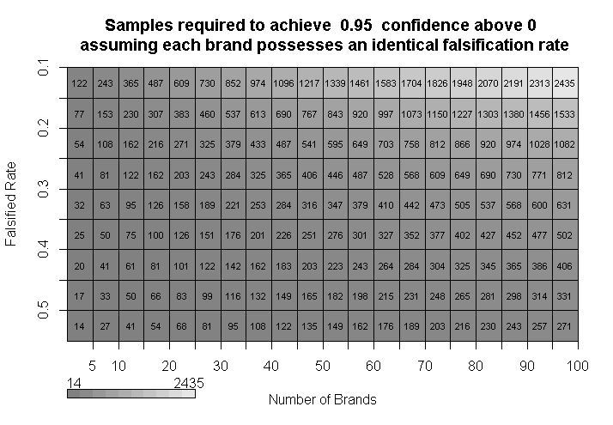
B* required to achieve 95% confidence above 0
By falsified rate and number of brands, with $t=0$
Prevalence
Fragmentation
27

Slide 28
Select medicines
Switch?
Update diagnostic tool
Sample
28
Notes:
Strategic Decisions
Drug types to test
Subset of pharmacies to study
Diagnostic Tool
Sensitivity + Specificity
Ability to detect API content + fillers
Influence of different levels of training
Effect or tradeoffs of tool modifications
DRA Environment
Drug supply-chain echelons
Rates of falsification / sub-standardization
Costs of falsification to illicit actors
Drug consumption rates
Levels of fragmentation of SSFFCs
Market distribution across fragments
Recall action timelines and limits
Lab/HPLC capacity
Drug market stakeholders
Operational Decisions
Financial + diagnostic sampling budget
Threshold for issuing recall action
Where + when + how much to sample

Slide 29
Moving forward
Establish the known parameters of the OR model
Recall time, batch throughput, HPLC capacity, etc.
Initialize a pilot study with a selected drug, focusing on key transit areas
Commit 300 PAD tests
After the pilot and respective confirmatory analyses at LMHRA and ND, synthesize results and consider future strategies
Expand testing approach if recall action feasibility seems strong
If a drug appears infeasible to test, switch drug classes and re-test
29

Slide 30
Mr. Akoi conducts a test with a PAD
Meeting Hon. Saah Joseph
30

Slide 31


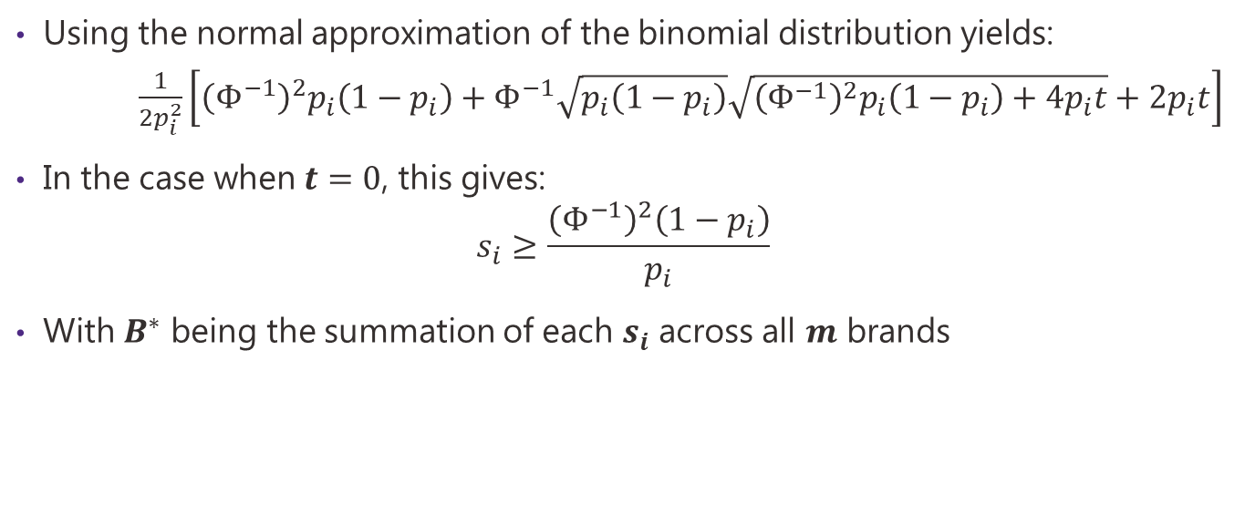
Feasibility example: Calculating $B^{∗}$
Using the normal approximation of the binomial distribution yields:
$\frac{1}{2p_{i}^{2}}\left[{\left(Φ^{−1}\right)}^{2}p_{i}\left(1−p_{i}\right)+Φ^{−1}\sqrt{p_{i}\left(1−p_{i}\right)}\sqrt{{\left(Φ^{−1}\right)}^{2}p_{i}\left(1−p_{i}\right)+4p_{i}t}+2p_{i}t\right]$
In the case when $t=0$, this gives:
$$s_{i}≥\frac{{\left(Φ^{−1}\right)}^{2}\left(1−p_{i}\right)}{p_{i}}$$
With $B^{∗}$ being the summation of each $s_{i}$ across all $m$ brands
$$s_{i}≥$$
31

Slide 32
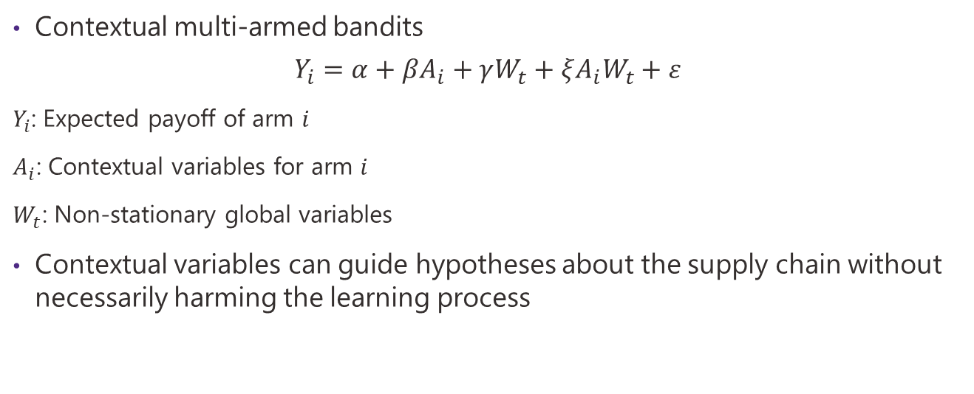
OR literature: Online experiment design
Contextual multi-armed bandits
$$Y_{i}=α+βA_{i}+γW_{t}+ξA_{i}W_{t}+ε$$
$Y_{i}$: Expected payoff of arm $i$
$A_{i}$: Contextual variables for arm $i$
$W_{t}$: Non-stationary global variables
Contextual variables can guide hypotheses about the supply chain without necessarily harming the learning process
32

Slide 33
Questions we want to answer
Iterative sampling should be targeted to answer crucial system unknowns
What are the dispersal patterns in falsified drugs throughout the supply chain?
Fragment concentration?
Scattered over time?
What does the fragment distribution look like?
What proportions of fragments capture what proportions of the market?
What unknown barriers exist for implementing a PAD-testing policy?
33

Slide 34


Feasibility example: Response time
Initial Batch Size
Detection time: Early
Recall period: Short
Drug Amount
Captured Product Amount
Diagnosis
Time
$$\overline{L}$$
$$R$$
34

Slide 35

Feasibility analysis: Response time
Initial Batch Size
Detection time: Adequate
Recall period: Long
Drug Amount
Captured Product Amount
0
Diagnosis
Time
$$\overline{L}$$
$$R$$
35

Slide 36
Drug selection
Must be sufficiently falsified
What factors make a drug attractive to falsify?
Cannot have an excessive number of fragments (too much sampling required)
API detection by the PAD
Should not be too vulnerable to storage conditions
Market distribution data available?
36

Slide 37
How might the problem present itself?
Underlying structure
Result
Low # of falsified brands
Falsifier sunk cost to reproduce a given drug brand
HIGH
LOW
High # of falsified brands
Falsifier opportunities to inject bad products
EARLY IN SC
Steady flow
REGULAR
LATE IN SC
Scattered flow
ERRATIC
EARLY IN SC
LATE IN SC
If the falsification rate is proportional to the market share, the market share can be used to determine the underlying falsification rate.
Market distribution
FLAT
INEQUAL
37

Slide 38
OR literature: Network interdiction
Washburn, A. , & Wood, R. K. (1995). Two-person zero-sum games for network interdiction.
“If the interdictor chooses to monitor arc (i , j) ∈ A , then the evader is detected with probability p_ij if the evader’s path includes arc (i , j).”
“This situation results in mixed-strategy solutions for both agents: the interdictor selects a probability that it will interdict each of the arcs in the network, and the follower selects a probability for choosing each path in the network.”
Goldberg (2017): “The evader’s payoff is a function, c , of the origin-destination pair selected, multiplied by the total probability of evasion on the path selected”
38

Slide 39
OR literature: Network interdiction
McLay, L. A. , Lloyd, J. D. , & Niman, E. (2011). Interdicting nuclear material on cargo containers using knapsack problem models.
Morton, D. P. , Pan, F. , & Saeger, K. J. (2007). Models for nuclear smuggling interdiction.
“The smugglers (attackers) maximize the amount of illegal materials sent from an origin to a destination. This can be formulated as a maximum flow problem. The defender, on the other hand, optimizes their interdiction decisions according to a budget constraint to diminish the optimal flow value.”
39

Slide 40
Passages removed from Section 4
%\begin{itemize} %\begin{itemize} %\item \textbf{Public supply chain}: The public supply chain operates as a push system, whereby the Central Medical Store (CMS) of the Ministry of Health (MOH), based in Monrovia, distributes supplies to each of the fifteen counties of Liberia on a quarterly basis. The CMS obtains medicines from a variety of procurement streams, with particular donors providing the supplies for certain afflictions (e.g., HIV/AIDS or malaria). General funding for the procurement of other medicines may come from the MOH's budget or from other donors such as USAID or the EU. Medical supplies are held at county depots and later sent to health facilities. %\item \textbf{Private supply chain}: As mentioned above, in Liberia there are only on the order of 15-20 active, licensed importers of medicines, and all of them are located in Monrovia. Additionally, there are only on the order of a few hundred licensed pharmacy outlets throughout the country that are legally permitted to sell higher grades of medicines such as antibiotics. Each of the licensed importers makes its own decisions regarding the procurement of different pharmaceuticals and registers these products with the LMHRA. Upon reception of the batch of medicines from the manufacturer or intermediary supplier, samples are tested by the LMHRA, and upon a passing test the batch is certified to be sold in Liberia. All privately owned pharmacies are obligated to only sell these certified drugs to the public. %\item \textbf{Illicit supply chain}: Broadly speaking, the borders of Liberia with Sierra Leone, Guinea, and Cote d'Ivoire are porous, translating to little movement difficultly for smugglers should they wish to bring falsified medicines into Liberia. It is also conceivable that these products could be brought through the ports of Monrovia. However, estimates of the overall presence of such medicines throughout the sanctioned supply chains are difficult to obtain. It was believed that those counties bordering these countries, due to their proximity and ease of access, stood at higher risk of having falsified medicines sold in their outlets. %\end{itemize} %\item Reagent availability for laboratory-based diagnostics is a significantly higher constraint than the time required to conduct such tests. Absent the presence of other diagnostics such as the PAD, this fact has clear effects on the feasibility of testing plans. Inexpensive and deploy-able diagnostics such as the PAD can then occupy an important role in the overall surveillance paradigm. %\item The recall process for SF medicines is initiated by any "Suspicious" diagnostic result. It triggers an immediate quarantine of the product and places it on a list of medicines used by inspection officers that are distributed throughout the country and who conduct surveys of the outlets within their purview. Confirmatory testing of suspicious products is then conducted at the central laboratory in the capital, Monrovia, or sent abroad to a regulatory agency partner within the West Africa region. Although a specific value for $R$, the recall period, was not precisely identified, it was believed that regional officers could check for the presence of quarantined medicines at the outlets inside their spheres within a week. %\item Multiple stakeholders of varying types were convinced that falsification is only a problem with respect to the unlicensed street vendors who sell medical products illegally from makeshift market stands or wheelbarrows. However, it was generally acknowledged that substandard manufacture and storage were issues of concern throughout the entirety of the public and private supply structures. Additionally, the neighboring nation of Guinea was cited by these same stakeholders as the primary genesis point of falsified medicines. The inspection officer for one region reported receiving reports on a monthly basis from border-control officials regarding the disruption of the smuggling of falsified products across checkpoints. It was reported by many that actors in Guinea possess some of the more sophisticated replication technology. %\item Amoxicillin, paracetamol, and anti-malarials were quoted by outlet proprietors as the most commonly stocked-out items they carried. In addition to these products, ampiclox, ampicillin, and doxycycline were mentioned most often as the most valuable medicines for these outlets to carry. The consistency of these reports across outlets indicates that SF tendencies might be most likely with respect to these products. %\item Of all outlets visited, the highest number of observed brands of the same medicine at one outlet was three. Feedback from outlet owners shows that they generally will only procure their next batch of a drug when the current batch is about to run out. Additionally, they tend to stick with the same importer from batch to batch. Most outlets reported that even when using the same importer, however, the manufacturer brands received from batch to batch tend to change, indicating that importers are highly active in pursuing the cheapest supplies available on the global market. One major importer acknowledged this behavior was the case for them, while another importer conversely reported that they tend to maintain the same global suppliers over time. Additionally, different responses were recorded from importers with respect to the use of intermediaries - mentioned above as a problematic aspect of the global supply system - as opposed to procuring from manufacturers directly. %\item For up to six months of the year, deleterious road conditions due to rain often mean that the entire southeastern region of Liberia is essentially cut off from Monrovia, making drug procurement extremely difficult. These conditions often drive considerable stock-out rates. According to Pisani et al. \parencite{pisani2019}, it should be highly suspected that these extended periods of stock-outs drive up the prevalence of falsified medicines in this region. % \item Post-market surveillance (PMS) of the private supply chain by the LMHRA occurs when budgets are available, with sample procurement signifying the largest obstacle to extensive sampling. When facing trouble procuring funds from the government, the LMHRA often receives its PMS budgets from various external organizations, but these budgets are often received in a piecemeal fashion and priorities for testing can sometimes be dictated by the donors as opposed to the LMHRA. As illustrated in Section 2.3, intermittent batches of testing resources may impact which batches of medicines are worth testing, depending on the time elapsed since the batch entered the market.%\end{itemize}

